Slide 1
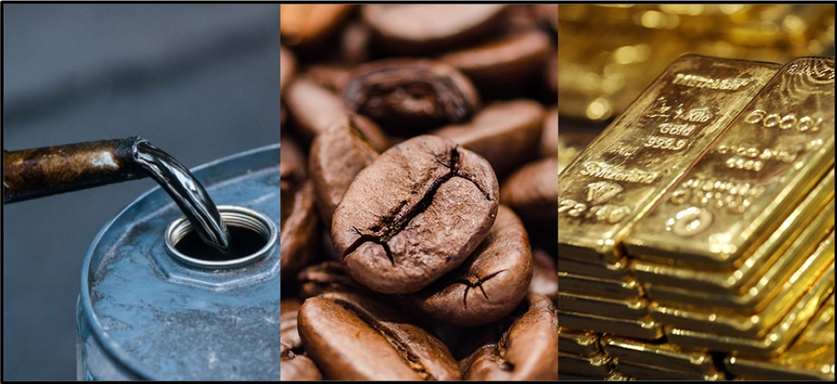

A systematic approach to Commodity Stock trading
Salma CHERAIBAT
Mohamad DAKKOURI
Salma ESSAOUI
Satnam SINGH
Jihane WADI

Slide 2




The commodity market
A commodity is a basic good used in commerce that is interchangeable with other goods of the same type.
Some traditional examples of commodities include grains, gold, beef, oil, and natural gas. More recently, the definition has expanded to include financial products, such as foreign currencies and indexes. Technological advances have also led to new types of commodities being exchanged in the marketplace. For example, cell phone minutes and bandwidth.
Applied Data Science in Finance
Notes:
Commodity and more specifically commodity stocks have been in the news recently, and the market has been expecting a commodity bull run that’s supposed to bring many capital gain opportunities for investors. So, as you’ve guessed it, the commodity market will be our focus for this fundamental systematic trading strategy quest, and we’ll try to look at the many different ways in which investors could benefit from an exposure to the commodity market.
But before we jump into the heart of the matter, let me rapidly explain what a commodity is:
A commodity is a basic good used in commerce that is interchangeable with other goods of the same type. Commodities are most often used as inputs in the production of other goods or services. The quality of a given commodity may differ slightly, but it is essentially uniform across producers.
Some traditional examples of commodities include grains, gold, beef, oil, and natural gas. More recently, the definition has expanded to include financial products, such as foreign currencies and indexes. Technological advances have also led to new types of commodities being exchanged in the marketplace. For example, cell phone minutes and bandwidth.
Like all assets, commodity prices are ultimately determined by supply and demand. For example, a booming economy might lead to increased demand for oil and other energy commodities. Supply and demand for commodities can be impacted in many ways, such as economic shocks, natural disasters, and investor appetite

Slide 3

Our Strategy
- Commodity stock trading
- Correlation between commodities futures and stock returns
- Elasticity analysis
Applied Data Science in Finance
Notes:
While commodity futures contracts provide the most direct way to participate in the price movements of the industry, there are additional types of investments with less risk that also provide sufficient opportunities for commodities exposure.
And from this investment opportunity group we choose to focus today on what is called a commodity stock.
In other words, our strategy will consist of benefiting from commodity market trends through the acquisition and sale of commodity levered stocks, in other words the stocks of companies which are directly involved in producing or manufacturing any type of commodities.
I’ll let discover the details about the relevance of such a strategy, and how it can be implemented in real life.

Slide 4
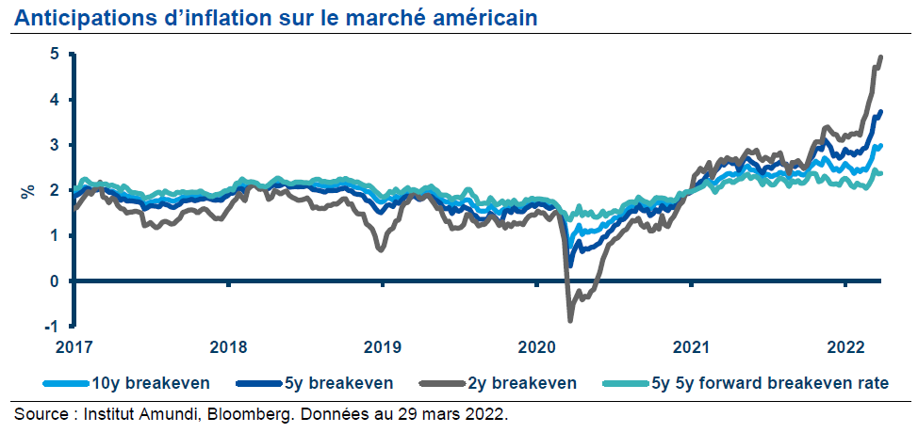
Why now ?
US Inflation Anticipation
Applied Data Science in Finance
Notes:
SS

Slide 5
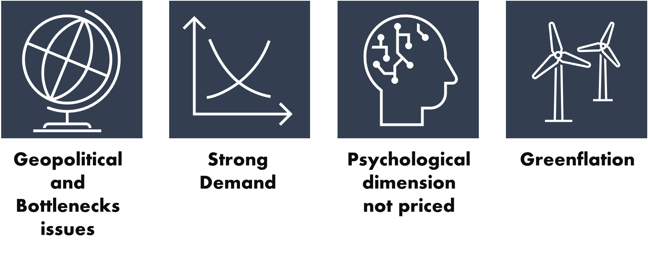
Why now ?
Factors boosting inflation
Long-term impact
Applied Data Science in Finance
Notes:
SS

Slide 6
The relevance of trading commodities
Importance of having exposure to the commodity market especially in inflationary periods:
They allow for portfolio diversification
Are a hedge against risky geopolitical events : Example of the current war crisis
Commodities as an asset class are highly correlated to inflation rates: they have outperformed all major asset classes during the 9 Fed hikes since 1972
Applied Data Science in Finance
Notes:
JW
Commodities have negative or low correlation with stocks as they usually are raw materials required to make the finished goods. This negative or low correlation with stocks makes commodities an enticing investment to achieve diversification in a portfolio
Geopolitical events such as conflicts, riots and wars disrupt the supply chain which leads to scarcity of resources, as it becomes difficult to procure and transport raw material to the factories where they are converted into finished goods. In such a case, the supply of the raw materials gets affected, which results in a mismatch of demand and supply, causing the prices of the commodities to rise exponentially. During such events there is pessimism in the market causing the stock prices to fall drastically. Hence, investing in commodities can help stem losses in an investment portfolio.
Commodity prices typically rise when inflation accelerates, which is why investors often flock to them for their protection during times of increased inflation—particularly unexpected inflation. As the demand for goods and services increases, the price of goods and services rises, and commodities are what's used to produce those goods and services.
Because commodities prices often rise with inflation, this asset class can often serve as a hedge against the decreased buying power of the currency.

Slide 7
The relevance of trading commodity stocks over commodities
Stock markets are more accessible and more straightforward for retail investors:
Commodity investments are costly in terms of minimal amount invested
Trades happen at spot price in equity markets vs Futures in the commodity market
Stocks are highly more liquid than commodity markets
Stocks don’t require frequent margin calls
Stocks are less volatile than futures contracts on commodities.
Applied Data Science in Finance
Notes:
JW
the minimum amount that can be invested in commodities is high, beyond the reach of most retail investors.
In commodities, most trading happens in futures. Commodity spot markets for retail investors are not well-developed in India. The first is that retail investors understand stock markets better than they can make sense of commodities markets. In stock markets, they can buy and sell stocks at current market prices, without the trouble of taking the futures route, which entails predicting future prices.
trading volumes in most commodities exchanges are low.
Another risk is that futures trading is based on margins (taking higher bets by paying a part of the total price). In volatile markets, investors need to have the capacity to pay for margin calls to gain from the uptrend.
Stocks are typically thought to be less prone to volatile price swings than futures contracts.

Slide 8
How would commodity trends provide us with equity trading cues ?
Commodity prices
Output-sensitive stocks
Input-sensitive stocks
Commodity producers
Oil extractors
Gold mines
Industrial companies
Paint industry…
Applied Data Science in Finance
Notes:
JW
Commodity prices impact the price of equity in two unique ways. Firstly, there are companies that are purely commodity companies. Companies that produce aluminium, iron ore, copper, and zinc are all examples of commodity driven companies. Similarly, oil extractors and gold mines are also examples of commodity producers. These companies are referred to as output-sensitive stocks where their business performance is directly dependent on the price of the commodity. These companies tend to do well when the commodity price is on an upswing. The second sets of companies where equities are impacted by commodity prices are known as input-sensitive stocks. These companies are into businesses which use commodities as inputs. For example the paint industry uses oil as an important input and the performance of these companies tend to outperform when the price of the commodity input is on a downswing.

Slide 9

Some Examples
Applied Data Science in Finance
Notes:
JW

Slide 10
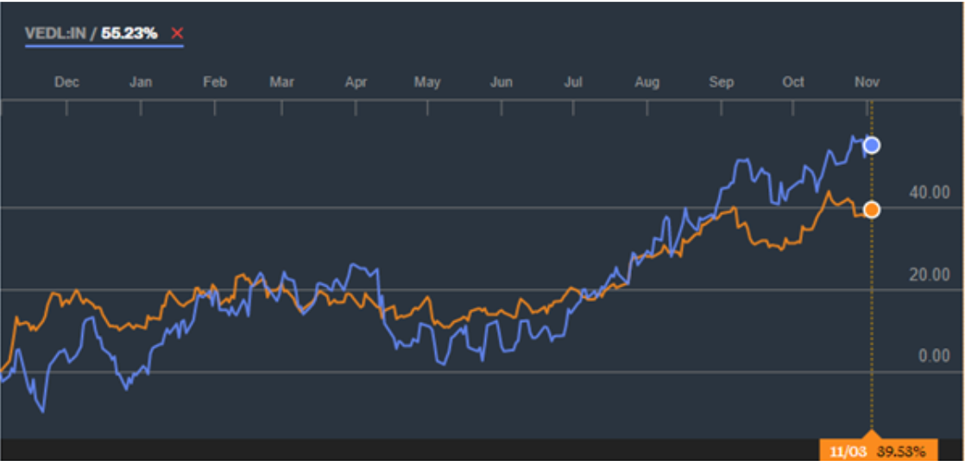
Upswing story: Copper prices and Vedanta stock price
Applied Data Science in Finance
Notes:
JW
To understand the story we have plotted the copper prices on the LME with the stock price of Vedanta. Remember, Vedanta is a global commodities conglomerate with exposure to zinc, aluminium, copper and even crude oil. Copper continues to be a major chunk of Vedanta’s performance. The chart below tracks the performance of Vedanta on the NSE with the price of copper on the LME.
The chart above clearly depicts a direct and almost proportional relationship between the global copper price and the stock price of Vedanta. While copper prices are up nearly 40% in the last 1 year, the stock of Vedanta is up by 55%. Copper prices are up due to a sharp revival in Chinese growth and expectations of a construction boom in the US once Trump implements his massive $1 trillion infrastructure plan.

Slide 11
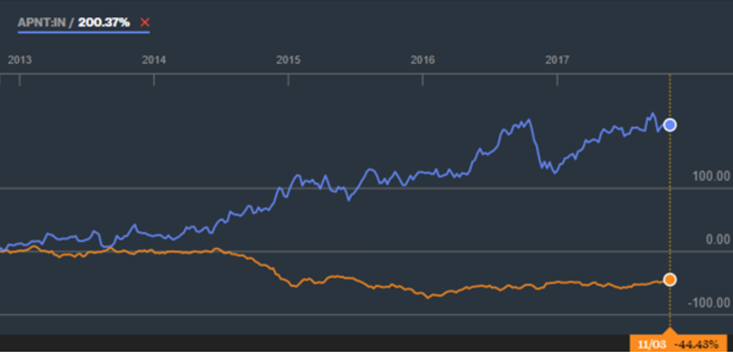
Downswing story: Crude oil versus Asian Paints
Applied Data Science in Finance
Notes:
JW
Having seen the output story playing out let also look at the input story play out with respect to crude oil. Consider the chart below.
To get a better perspective of the downswing story we have plotted the price of crude oil in the Brent market with the stock price of Asian Paints. There is a clear negative relationship between the two. For example, during the 5 year period, the price of Brent crude is down by (-44%) while the price of Asian Paints is up by 200%. If you look at the chart closely, both these graphs are almost parallel till late 2014 when the oil price crash started. The entire divergence in performance has come after that. This is a clear example of Asian Paints benefitting substantially from a sharp fall in crude oil prices leading to lower input costs.

Slide 12
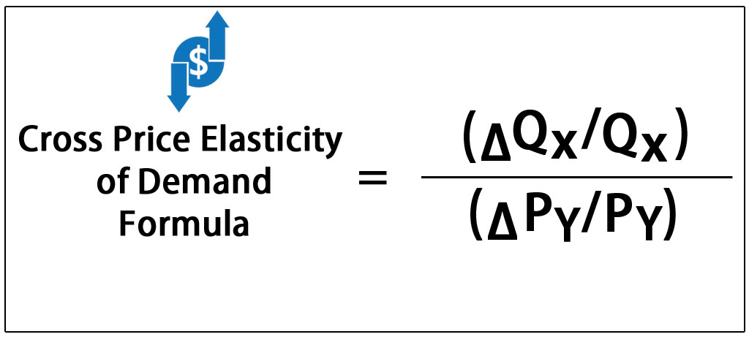
How to distinguish input from output sensitive stock ?
Earning elasticity of price analysis:
Applied Data Science in Finance
Notes:
- Elasticity is an economic measure of how sensitive an economic factor is to another.
- Price elasticity measures the relationship between the supply and demand of a commodity and its price.
- If the price of a good or service easily affects supply or demand, it is described as elastic. Alternatively, if price of a commodity has little impact on supply and demand, it is described as inelastic.
-Price elasticity of supply measures how the price of a commodity affects the quantity supplied.

Slide 13
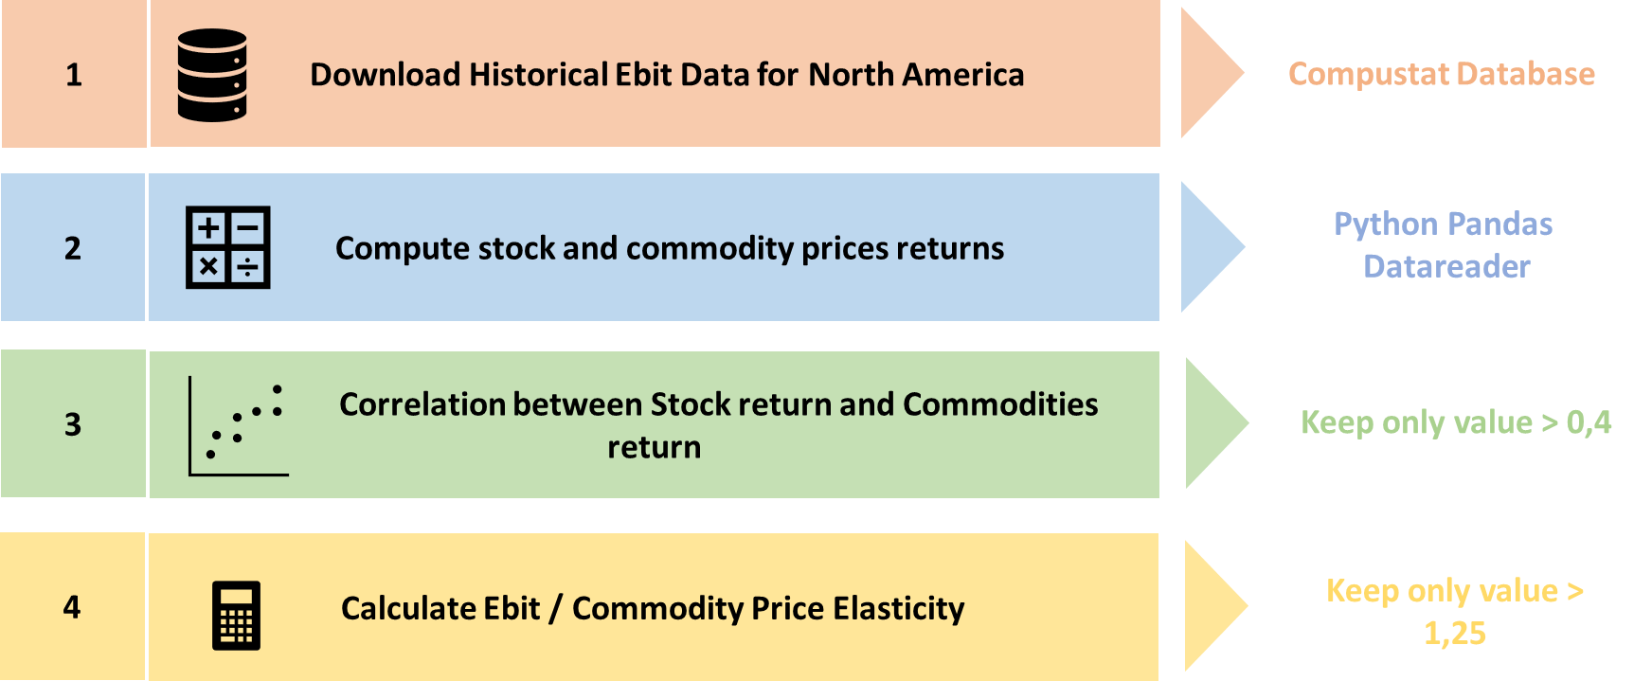
Implementation of the strategy
Applied Data Science in Finance
Notes:
SS

Slide 14
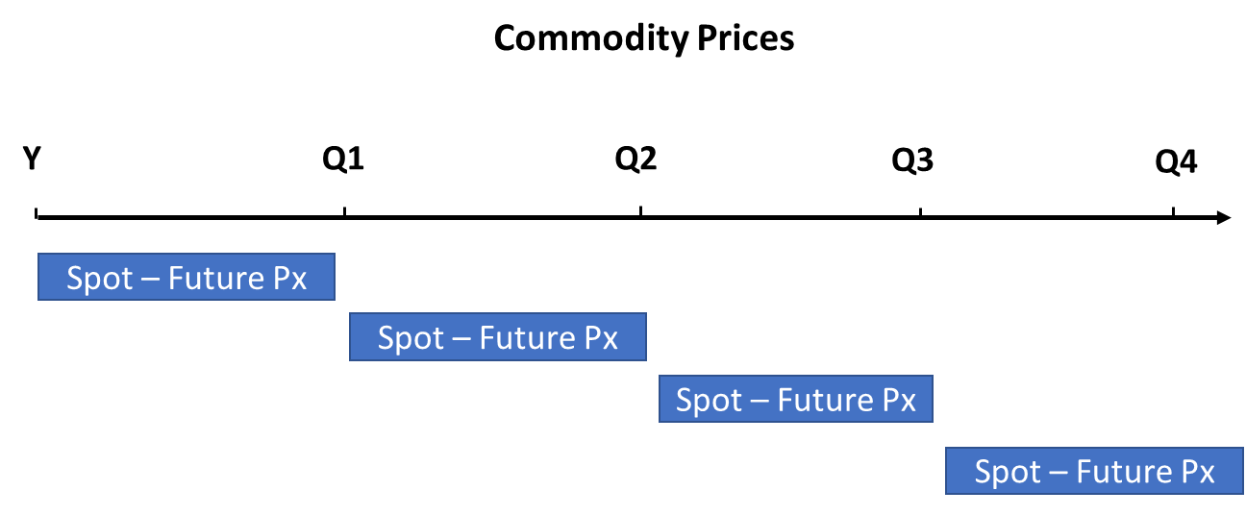
Trading Signal
Open Long position if Spot Price is < Future Price
Applied Data Science in Finance
Notes:
SS

Slide 15
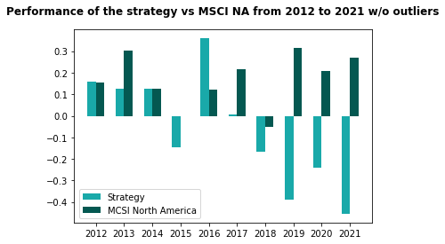
BackTesting
Applied Data Science in Finance
Notes:
SE
This is plot showing a performance comparison between our adopted strategy and the MSCI performance from 2012 to 2021 with removing outliers
Here we can see that during the first years our strategy seems to be coherent with the MSCI performance NA as our benchmark then starting from 2018 the strategy is obviously outperforming the index

Slide 16
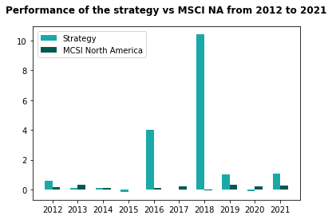
BackTesting
Applied Data Science in Finance
Notes:
SE

Slide 17
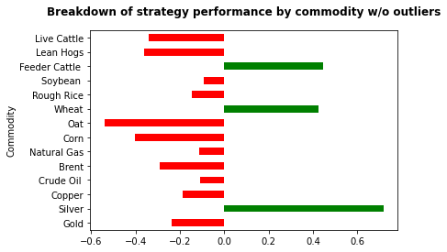
BackTesting
Applied Data Science in Finance
Notes:
SE
We can clearly notice that 3 among 14 commodities are considerably the most performing ( feeder cattle, wheat and silver )

Slide 18
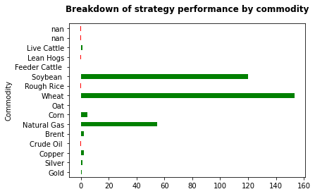
BackTesting
Applied Data Science in Finance
Notes:
SE

Slide 19

Improvement areas
Complete our reasoning by introducing other metrics (Debt to equity ratio, Price earning ratio, 1 year return) so as to get a global view
Monitoring the inventories/stock of manufacturers and confectionners could be an index on expected supply and demand and could thus be used as price indicators
Price aug = stock aug (monitoring inventories could thus be an indicator on price)
Market Capitalization : In our strategy, it is possible that we may be trading on illiquid stocks or small market capitalization, it could be therefore relevant to take into account Market Caps
Our selection of commodities does not include metals related to the energy transition (nickel, lithium, etc.) whereas it would be relevant to link them to certain stocks (semi conductor or automotive producers for example)
Applied Data Science in Finance
Notes:
There are some relative disadvantages to investing in stocks as a way of gaining access to the commodities market. Stocks are never a pure-play on commodity prices. In addition, the price of a stock may be influenced by company-related factors that have nothing to do with the value of the related commodity that the investor is trying to track.

